Slide 1
Ultimate Technologies Inc.
Springboard Take-home interview challenge
Jeffrey Jex, June 2021

Slide 2
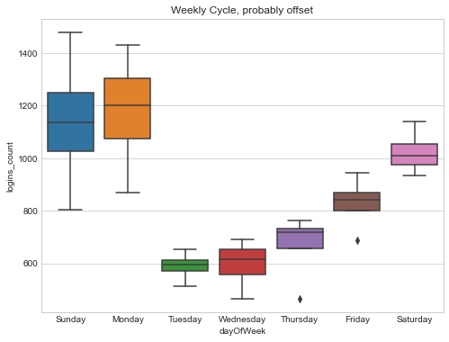
Part 1 EDA: Data Quality
Provided: JSON file of login timestamps from Jan-mid April
The time stamp starts off in Jan 1st 1970 This poses 2 issues
The year is wrong
The days of the week are probably wrong, placing weekends on weekdays. Data has strong weekly cycle, this needs resolved.

Slide 3
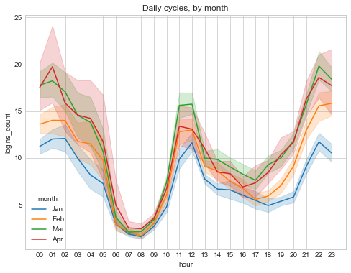
Part 1 EDA: Daily Cycle
Typical day:
Low usage from 6 am - 10 am.
Peak at lunch time, 11-12
Low usage for the afternoon
Evening-highest usage
peaking ~midnight as establishments close and folks need a ride home
Closing time
Lunch
Morning trough

Slide 4
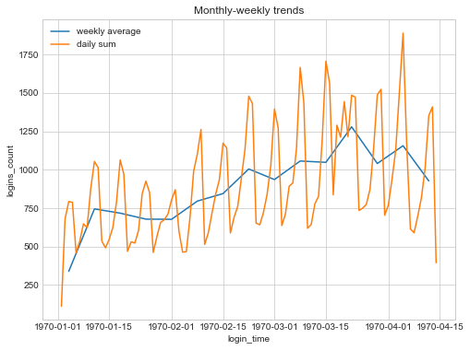
Part 1 EDA: overall trends
Sharp rise in February.
Possibly due to a promotion or other business change.
March-April more volatility
Higher peaks but a potential overall decline in April begins
Strong weekly cycle
Strong consistent signal aside from something in the later half of March. Perhaps holiday or big event?
Event?

Slide 5



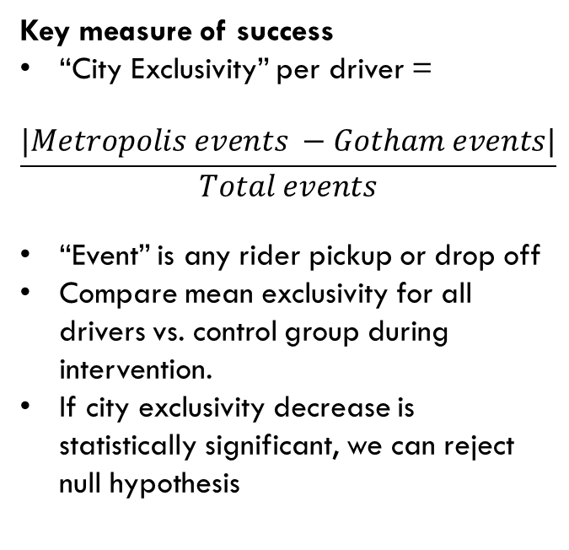
Part 2: Setup
Hypothesis
Drivers typically serve clients in only one city due to toll cost. Reimbursing all toll costs will lead to more drivers serving both cities.
Null Hypothesis
Driver behavior is not effected by reimbursing tolls.
Key measure of success
“City Exclusivity” per driver =
$$\frac{|Metropolis events −Gotham events|}{Total events}$$
“Event” is any rider pickup or drop off
Compare mean exclusivity for all drivers vs. control group during intervention.
If city exclusivity decrease is statistically significant, we can reject null hypothesis
Metropolis
Active at day
Toll bridge
Gotham
Active at night
These Photo by Unknown Author is licensed under CC BY-NC

Slide 6
Part 2: Study Design
Implementation:
Split Metropolis & Gotham driver partners randomly into two groups (50/50 split)
Control group – no intervention
“Challenger” group – Reimburse all tolls during study
Sample Size
Must achieve sufficiently large sample size to have meaningful results. Depends on our number of drivers and test duration.
As a rough estimate, two weeks – four weeks of data collection should be sufficient. More time gives more confidence in results.
Statistical Tests
Welch’s t-test: used to compare the statistical similarity of population means.
Result interpretation
Challenger group city exclusivity mean is x with a confidence interval of [P-value from Welch’s t-test].
A decrease in city exclusivity mean from the control indicates rejection of the null hypothesis
Staying the same or increasing indicates null hypothesis is correct.
Caveats
This tests if reimbursing all toll cost has a correlation with city exclusivity.
Correlation is not causation.
Assume drivers understand the they will be reimbursed
Assume drivers view reimbursement as equivalent to ‘not paying the toll’ in real-time
Assume the toll is the only reason drivers aren’t visiting

Slide 7
Part 2: Study Design
Splitting control vs challenger
Split all drivers randomly 50/50
Preserve distribution of driver’s primary city. I.e. if 60% of drivers work in metropolis, then 60% of the challenger and control groups should be primary drivers in metropolis. (If split is truly random and we have > 100 drivers, this should take care of itself).
If needed, we can reduce total study population to less than all drivers, but don’t shrink beyond 10% of total. Just keep in mind smaller sample means less confidence.
Additional considerations
Consider adding in other ‘challenger’ groups with only a portion of the toll paid, or x many tolls paid per day in future studies.
Compare driver past city exclusivity values to value during AND AFTER study. Does the city exclusivity return to prior level after the intervention ends? If so, how long does it take?
Are there confounding variables not taken into account? Heavy traffic on the bridge, prejudices between cities, time-of day work that may effect driver events between cities.

Slide 8
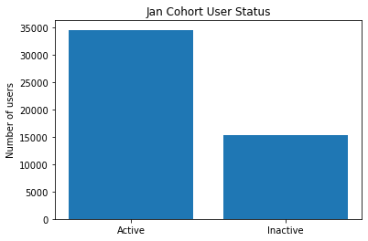
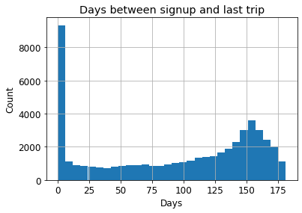
Part 3: EDA, what fraction of observed users retained?
Retained 69% of Jan cohort after 30 days
69%
31%

Slide 9
Part 3 : Predictive model (active after 6 months?)
Chosen approach
Random Forest
Best score
Doesn’t require data scaling
Doesn’t require PCA
Fast to predict
Training process easily scales with parallel computing AKA well suited for scaling with cloud
Alternatives considered
Logistic regression
Lower score than RF
Decision tree
Prone to overfitting
Model | Score
Random forest: | 0.7519
Random Forest with PCA: | 0.5334
Logistic Regression: | 0.6682
Logistic Regression with PCA: | 0.6683

Slide 10
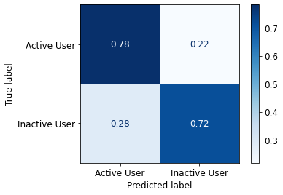
Part 3: Concerns, model validity, key indicators
Model Accuracy: 74 %
Model was trained on 40,000 points and tested on hold out set of 10,000.
Concerns:
Random forest is hard to interpret ‘black box’. May include unwanted bias from inputs.
Random forest is prone to overfitting in some cases, especially with small data sets (didn’t appear to happen here).
Correct
predictions
Correct
predictions

Slide 11
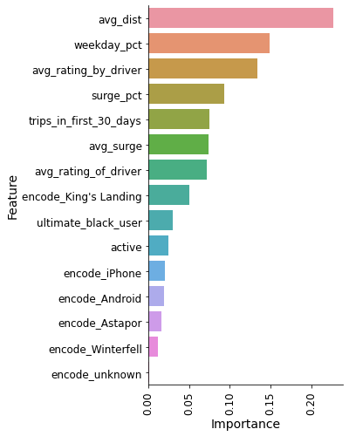
Part 3: insights to actions
Those who travel farther (avg_dist) and higher weekday percent are more likely to be a customer after 6 months
Action: Have marketing focus on commuters
Location and device type don’t matter very much (low importance)
Don’t get stuck on one device or area, under-used areas or device types may have untapped market.
Use model to predict potential churn customers
Run promo experiments to “at risk of leaving” customers to improve longevity

